Slide 1
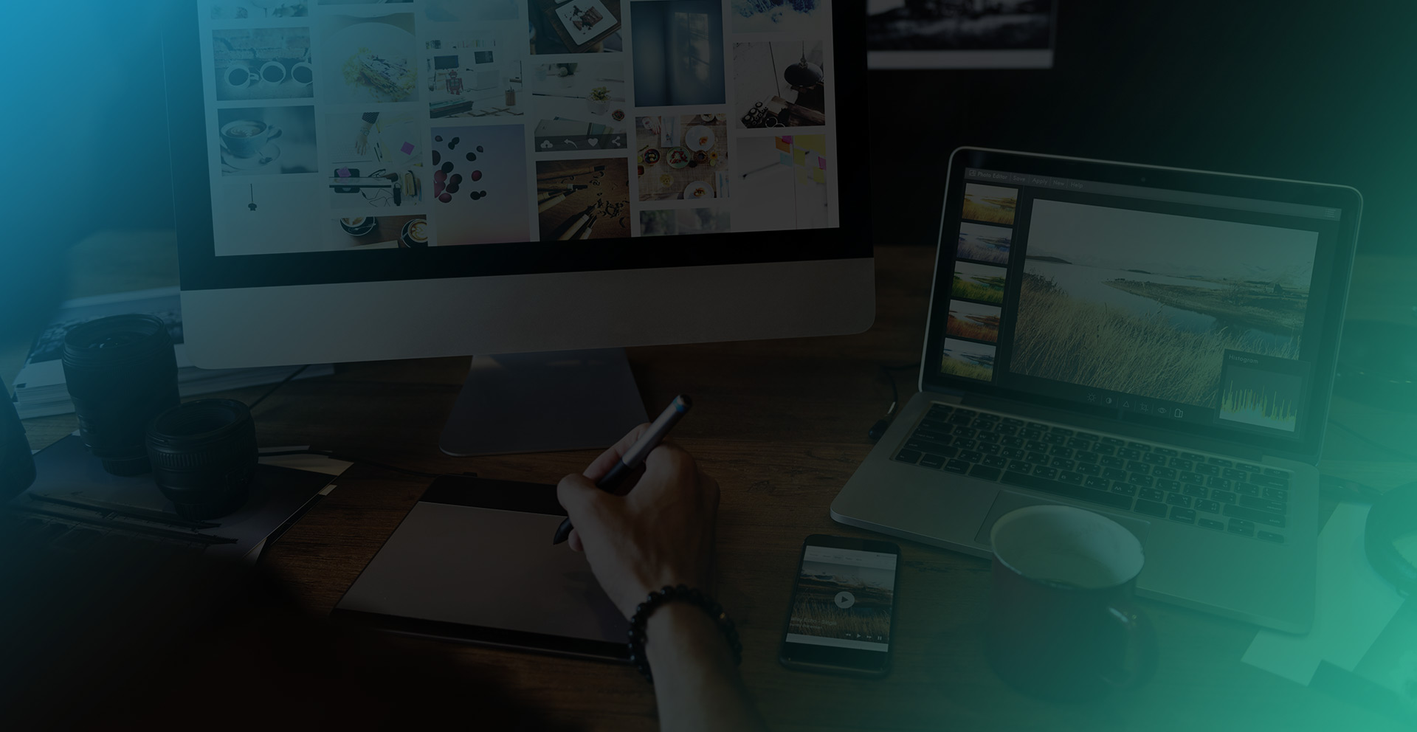
PROVIDING
Custom Web Designs
and Marketing Support
SUPPORT
For businesses
of all sizes.

Slide 2
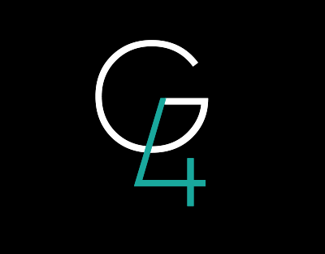
BUSINESSES OF ANY SIZE
Full-Service agency, focusing on enhancing your digital footprint
DESIGN, MEDIA, & MARKETING SERVICES

Slide 3
At G4, our commitment is
to provide services that
exceed expectations.
As a boutique agency,
we pride ourselves on building client relationships that are long-term and growth-oriented.

Slide 4
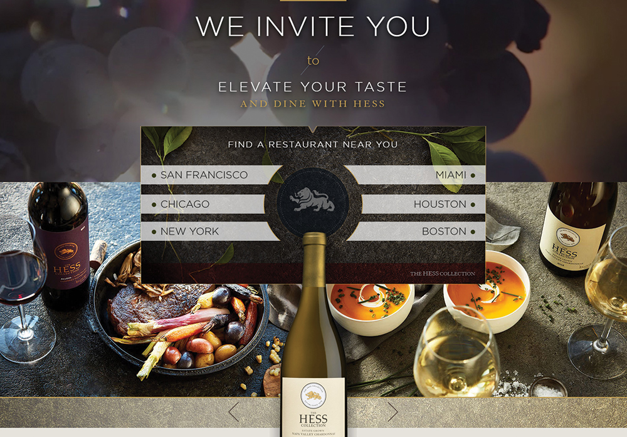
We always assure to properly incorporate into the design form and function with the proper UI/UX techniques ... And Designs that come to life:

Slide 5
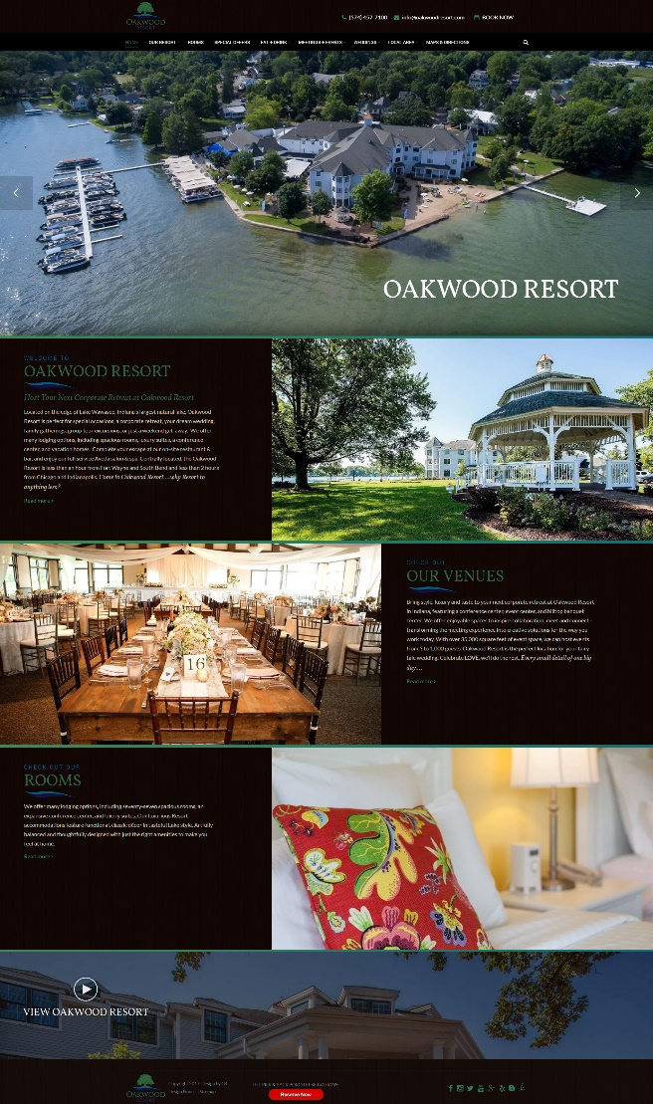
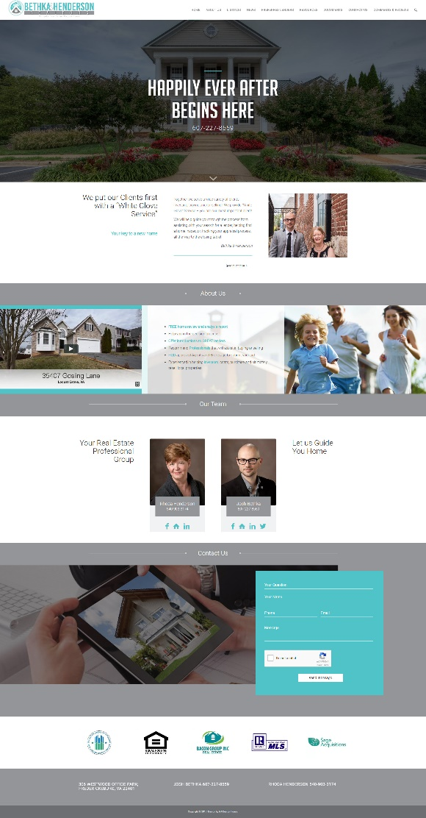
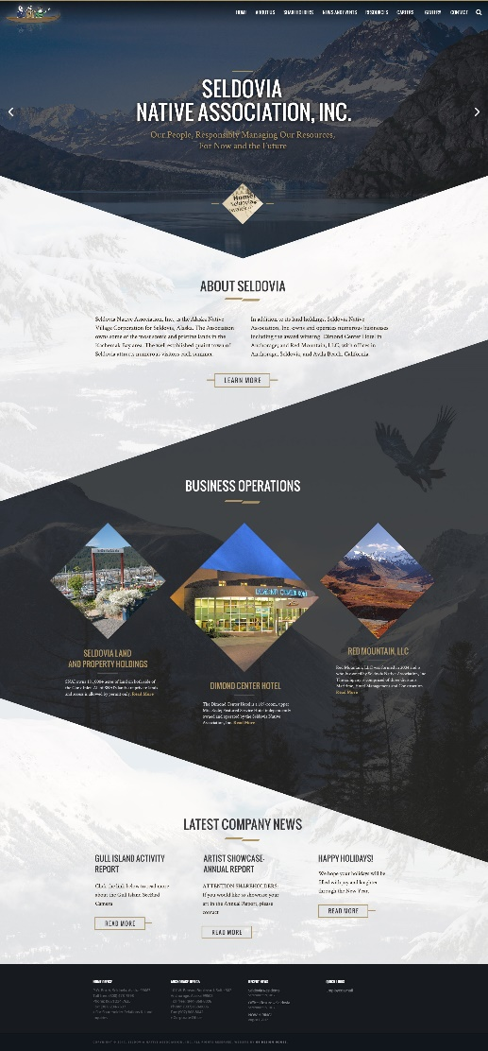
We understand the hard work, dedication and passion that goes into running your business.
We approach every client’s project with that same passion and dedication.
Helping
Your Business
Succeed
Whether we’re creating a corporate branding/lead generation website or a custom eCommerce site, G4 is skilled and building a performance driven website in any and ALL verticals.
What’s Included:
Design customization, hosting, premium content management, onsite SEO, security, maintenance and so much more!

Slide 6
Service
“Excellent customer service is the number one job in any company! It is the personality of the company and the reason customers come back. Without customers there is no company!”
At G4, we understand what you need - and it’s as simple as this… someone who picks up the phone when you call and follows through on your request.
Together, we will work to define and execute your vision. As a San Diego boutique agency, our team is just around the corner.

Slide 7
Technical
Capabilities
WordPress or HTML Development
eCommerce Development
Design: Branding, Logos, Graphics, Brochures, etc.
Experts in Photoshop, Illustrator & other Adobe Suite products
Foundation and Bootstrap Frameworks
Database Development (MySQL, .Net)

Slide 8
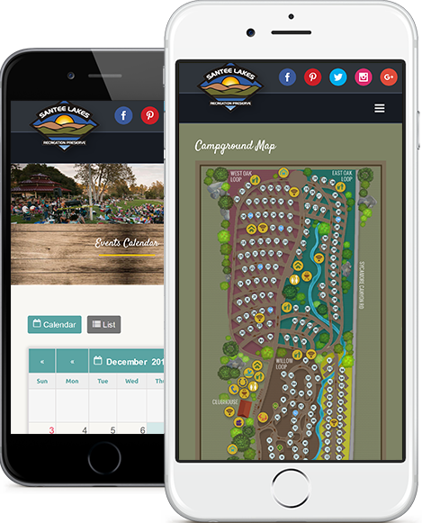
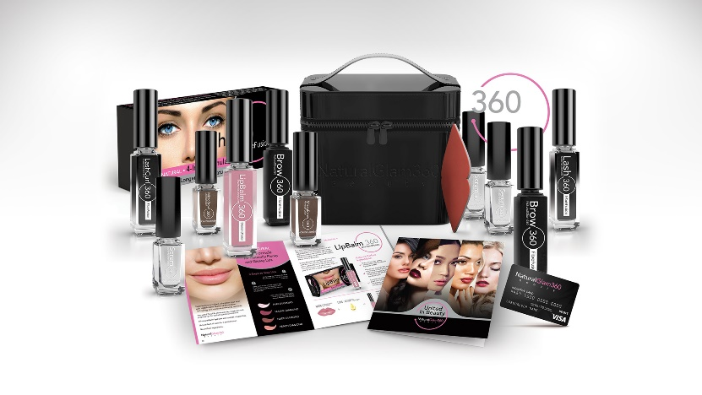
Branding
Logo Design
Brochures
Flyers
Tri-Folds
Infographics
Packaging

Slide 9
“
More
G4 Design House offers an easy and quick solution for quality content. I can trust the content I receive back will be well written, researched, and will align with my provided outlines.
Deb Tracy President,
www.SignAnimations.com
Blog
Posts
White
Papers
Product
Descriptions
Website
Content

Slide 10
Increase Revenues through the G4 Marketing Platform
Our marketing experts create performance driven marketing campaigns that aim to increase ROI
Search
Engine Optimization
Leap past your competitors in organic search results
Paid
Search
Acquire immediate clicks, which means immediate leads
Display Advertising Create visually engaging banner ads that convert at high rates
Email Campaigns
Target qualified email lists for a higher rate of open with minimal costs
Content Marketing
Get high quality content published on publications with Authority

Slide 11
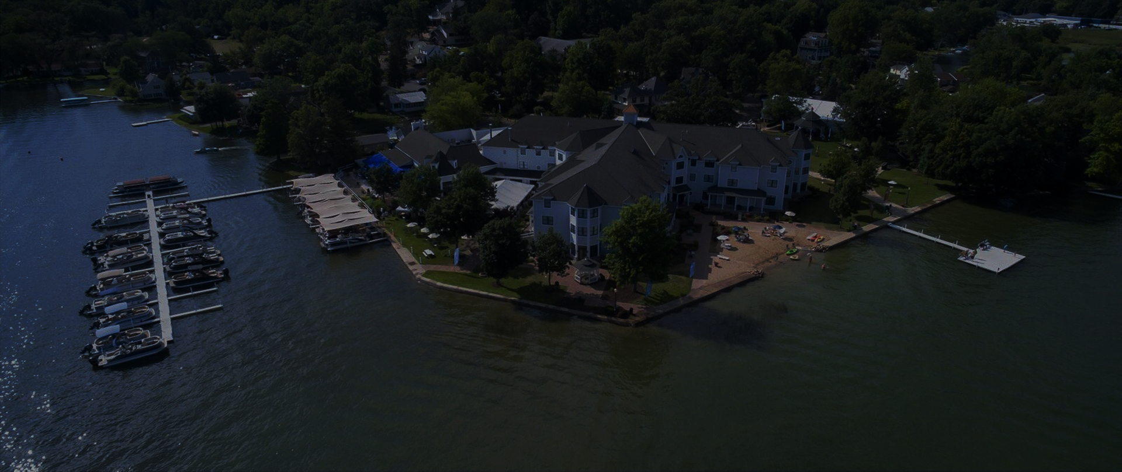
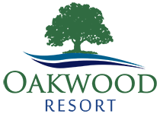
1. Objective
The resort needed to increase their corporate retreat business in the major cities of Chicago and Indianapolis.
2. Strategy
3. Results
The resort reached out to G4 to help them create and develop a new website and marketing campaign to increase their organic presence on the major search engines.
We decided that a clean new WordPress site with a build-in CMS would be the most effective and cost efficient way to proceed. We saved them thousands of dollars in development cost which allowed them to invest in the marketing they urgently needed.
Increased organic traffic from 1200 to 6800 or over 560%
Effectively GEO-Targeted – Took middle of state Indiana independent resort lifted multiple corporate meeting terms to page 1 in major markets such as Chicago and Indianapolis
Lifted 59 terms to page 1 Google
Increased Google term “recognition” from 88 to 778 in 9 month period.
Case Study

Slide 12
1. Objective
Create a successful campaign to target a small audience in a highly niche market in the technical industry.
2. Strategy
3. Results
Our strategy on this campaign was to target only specific and small areas of the country.
Our research indicated that the likely buyers of their product were localized to areas of the coun try that had a higher demand for their specific capabilities.
We would adjust the bids based on the region making sure that the spend was far more efficient.
Increased Lead Conversions by 500%
Each month we ran the campaign, assessed the results and made slight modification to increase our return. Each month we increased conversions by 50%
Our client was able to convert 50% of those leads
Case Study

Slide 13
THANK
YOU

